Slide 1



Digital Electronics
Class X
lab 18

Slide 2
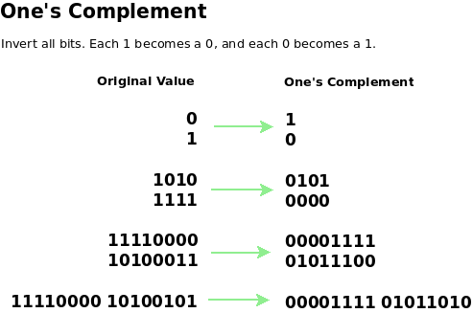
1’s complement
transforming the 0 bit to 1 and the 1 bit to 0

Slide 3
1’s complement Examples
1's complement of 7 (0111) is 8 (1000)
1's complement of 12 (1100) is 3 (0011)

Slide 4
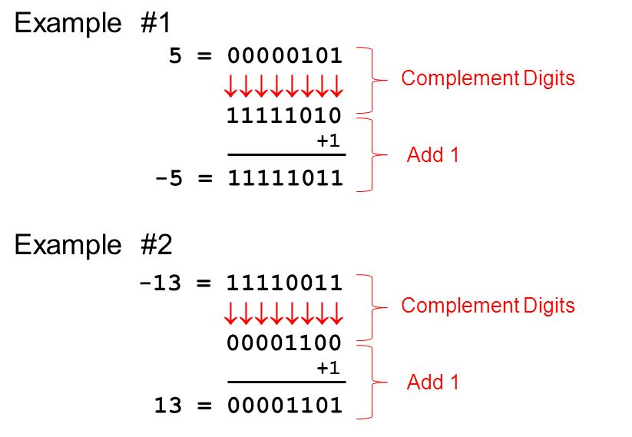
2’s complement Examples
1 is added to the 1’s complement of the binary number

Slide 5
Boolean Postulates
(1) | A + 0 = A | A · 1 = A | identity
(2) | A + ^{NOT}[A] = 1 | A · ^{NOT}[A] = 0 | complement
(3) | A + B = B + A | A · B = B · A | commutative law
(4) | A + (B + C) = (A + B) + C | A · (B · C) = (A · B) · C | associative law
(5) | A + (B · C) = (A + B) · (A + C) | A · (B + C) = (A · B) + (A · C) | distributive law

Slide 6
Boolean Algebra
(6) | A + A = A | A · A = A
(7) | A + 1 = 1 | A · 0 = 0
(8) | A + (A · B) = A | A · ( A + B) = A
(9) | A + (^{NOT}[A] · B) = A + B | A · (^{NOT}[A] + B) = A · B
(10) | (A · B) + (^{NOT}[A] · C) + (B · C) = (A · B) + (^{NOT}[A] · C) | A · (B + C) = (A · B) + (A · C)
(11) | ^{NOT}[A + B] = ^{NOT}[A] · ^{NOT}[B] | ^{NOT}[A · B] = ^{NOT}[A] + ^{NOT}[B] | de Morgan's theorem

Slide 7
Thank You

